Slide 1
DATABASE SCHEMA DESIGN
LogiChat

Slide 2
TABLES
01
RELATIONSHIPS
02
TABLE OF CONTENTS
DATABASE SCHEMA
03
ROLES & PERMISSIONS
04
Overview of tables needed for the app to function
Relations existing among tables
Proposed database schema
Overview of roles and assigned permissions to roles

Slide 3
01
TABLES
Overview of tables needed for Chat Application to function

Slide 4
TABLES
USERS
MESSAGE_RECIPIENT
MESSAGE
STATUS
ROLE
GROUP
PINS
TASK
ROLE_HAS_PERMISSIONS
USER_GROUPS
PINNED_USERS
PERMISSIONS
TASK_OWNERS

Slide 5
02
RELATIONSHIPS
Relations existing among tables

Slide 6
USER RELATIONSHIPS
USER_GROUP
ROLE
TASK
STATUS
TASK_OWNERS
USER
MESSAGES
MESSAGE_RECIPIENT
PINNED_USER

Slide 7
USER GROUP RELATIONSHIPS
USER
GROUP
USER GROUP
MESSAGE_RECIPIENT

Slide 8
ROLE_HAS_PERMISSIONS RELATIONSHIPS
ROLE
ROLE_HAS_PERMISSIONS
PERMISSION

Slide 9
03
DATABASE SCHEMA
Structure of proposed database

Slide 10
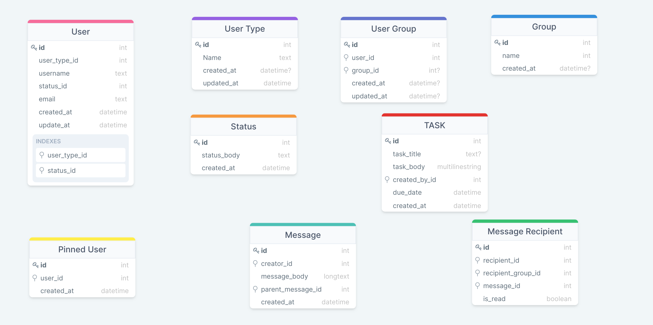

Slide 11
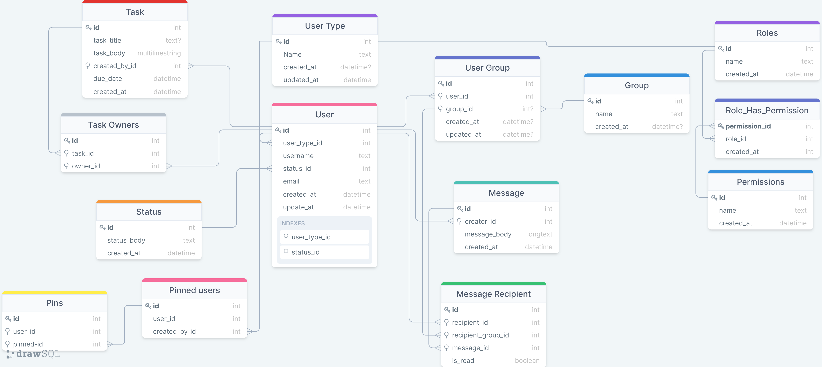

Slide 12
04
ROLES & PERMISSIONS
You can enter here the subtitle if you need it

Slide 13
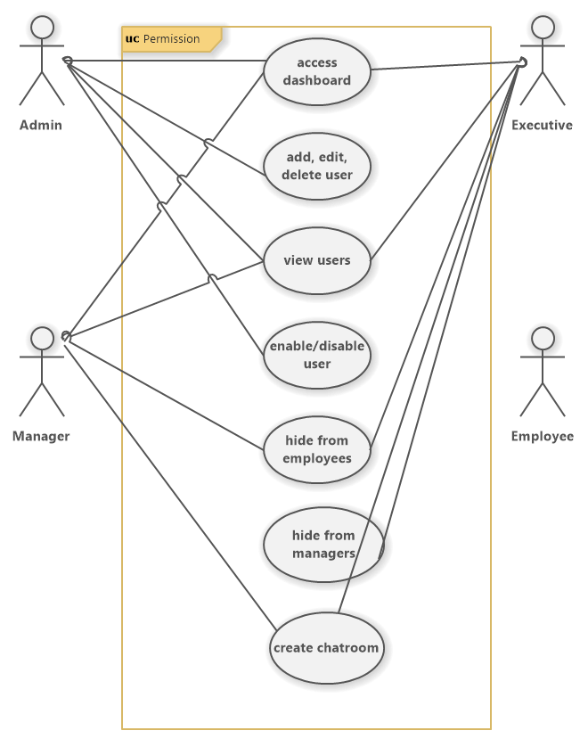
PERMISSIONS & ROLES

Slide 14
THANK YOU

